Slide 1
IoT communication technologies

Slide 2
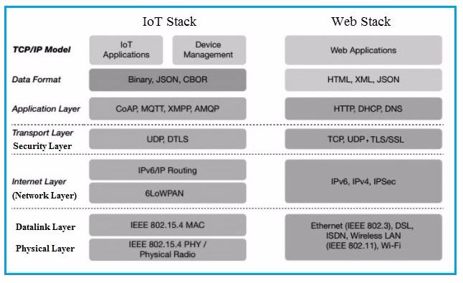
Technical Deviations from Regular Web

Slide 3
Considerations
Communication between the IoT device(s) and the outside world dictates the network architecture.
Choice of communication technology dictates the IoT device hardware requirements and costs.
Due to the presence of numerous applications of IoT enabled devices, a single networking paradigm not sufficient to address all the needs of the consumer or the IoT device.

Slide 4
Functionality-based IoT Protocol Organization
Connectivity
6LoWPAN,RPL
Identification
EPC, uCode
Discovery
Physical Web
mDNS,DNS-SD
Communication/Transport
IPv6,URIs
WIFI,Bluetooth,NFC,
LPWAN
Data Protocols
MQTT,CoAP,AMQP,
WebSockets,Node
Device Management
TR‐069, OMA‐DM
Semantic
JSON‐LD, Web Thing Model
Multi‐layer Frameworks
Alljoyn, IoTivity, Weave, Homekit

Slide 5
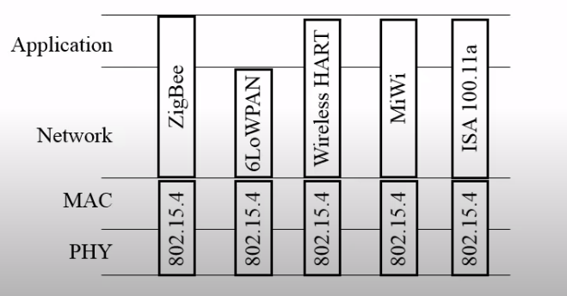
IEEE 802.15.4

Slide 6
IEEE 802.15.4
Well‐known standard for low data‐rate WPAN.
Developed for low‐data‐rate monitoring and control applications and extended‐life low‐power‐consumption uses.
Short range, low bit rate, low power consumption
Home
Automotive
Industrial applications
Games
Metering
This standard uses only the first two layers (PHY, MAC) plus the logical link control (LLC) and service specific convergence sub‐layer (SSCS) additions to communicate with all upper layers
Operates in the ISM band.
Application Layer
Presentation Layer
Network Layer
Session Layer
LLC
Transport Layer
IEEE 802.15.4
SSCS
Network Layer
Data Link Layer
MAC
Physical Layer
Physical layer

Slide 7
IEEE 802.15.4
Uses direct sequence spread spectrum (DSSS) modulation.
Power consumption is minimized due to infrequently occurring very short packet transmissions with low duty cycle (<1%).
Highly tolerant of noise and interference and offers link reliability improvement mechanisms.
Low‐speed versions use Binary Phase Shift Keying (BPSK).
High data‐rate versions use offset‐quadrature phase‐shift keying (O‐QPSK).
Uses carrier sense multiple access with collision avoidance (CSMA‐CA) for channel access.
Multiplexing allows multiple users or nodes interference‐free access to the same channel at different times.
Transmission, for most cases, is Line of Sight (LOS).
Standard transmission range varies between 10m to 75m.
Best case transmission range achieved outdoors can be upto1000m.
Networking topologies defined are ‐
Star, and Mesh.

Slide 8
IEEE 802.15.4 Variants
A/B
C
D
E
F
Base version
For China
For Japan
Industrial applications
Active RFID uses
G
Smart utility networks (Smart Grids)

Slide 9
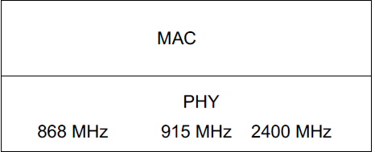
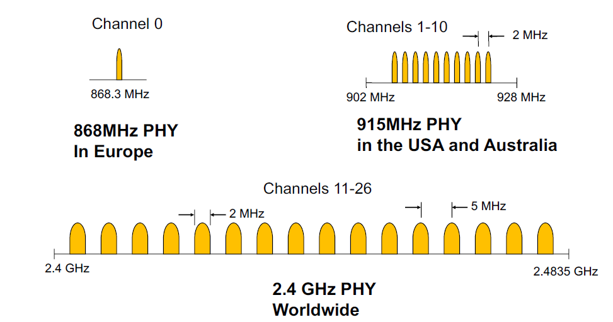
802.15.4
Channels
• 16 channels in the 2.4 GHz ISM band
• 10 channels in the 915 MHz ISM band in the USA
and Australia
• 1 channel in the European 868 MHz band
• 1 channel in China’s 784 MHz band
IEEE 802.15.4 PHY Overview Operating Frequency Bands

Slide 10
IEEE 802.15.4 Device classes
802.15.4
FFD
PAN coordinator
Router
RFD
Device
Device
IEEE 802.15.4 Frames
Frames
Beacon
MAC
Command
Acknowledgement
Data
Full Function Device (FFD)
• Can talk to all types of devices
• Supports full protocol
Reduced Function Device (RFD)
• Can only talk to an FFD
• Lower power consumption
• Minimal CPU/RAM required

Slide 11
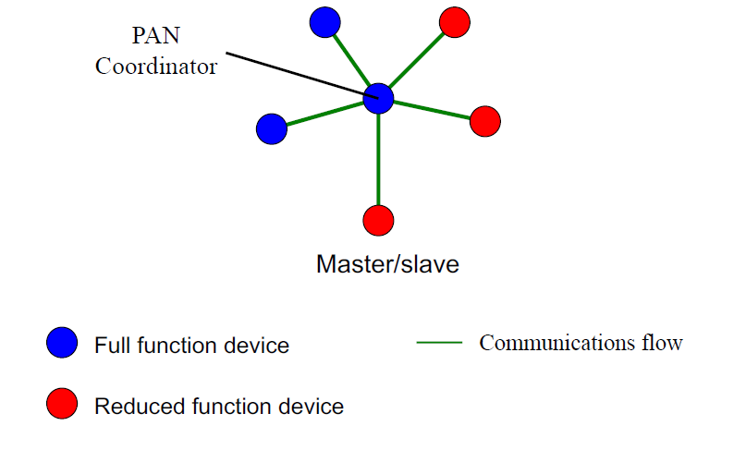
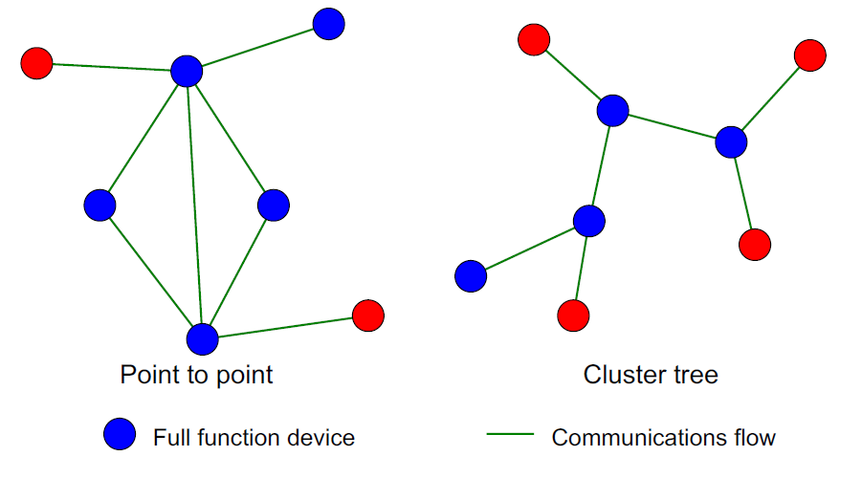

Topology
IEEE 802.15.4 MAC Star Topology
IEEE 802.15.4 MAC Peer to peer Topology

Slide 12
IEEE 802.15.4 Networks
Beacon Enabled Networks
Periodic transmission of beacon messages
Non-Beacon Enabled Networks
Data‐frames sent via un‐slotted CSMA/CA (ContentionBased)
Data‐frames sent via Slotted CSMA/CA with a superframe structure managed by PAN coordinator
Beacons used for synchronization & association of other nodes with the coordinator
Scope of operation spans the whole network.
Beacons used only for link layer discovery
Requires both source and destination IDs.
As 802.15.4 is primarily, a mesh protocol, all protocol addressing must adhere to mesh configurations
De‐centralized communication amongst nodes

Slide 13
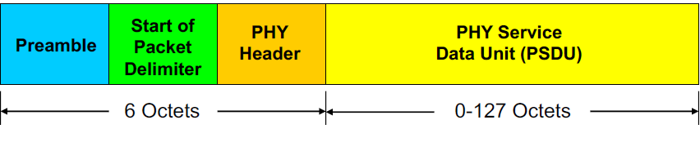
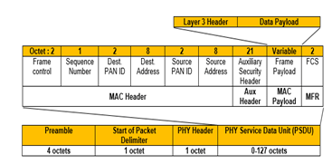
IEEE 802.15.4 PHY Overview Packet Structure
PHY Packet Fields
• Preamble (32 bits) – synchronization
• Start of Packet Delimiter (8 bits)
• PHY Header (8 bits) – PSDU length
• PSDU (0 to 1016 bits) – Data field
IEEE 802.15.4 MAC Overview
General Frame Structure

Slide 14
ZigBee
Most widely deployed enhancement of IEEE 802.15.4.
The ZigBee protocol is defined by layer 3 and above. It works with the 802.15.4 layers 1 and 2.
The standard uses layers 3 and 4 to define additional communication enhancements.
These enhancements include authentication with valid nodes, encryption for security, and a data routing and forwarding capability that enables mesh networking.
The most popular use of ZigBee is wireless sensor networks using the mesh topology.

Slide 15
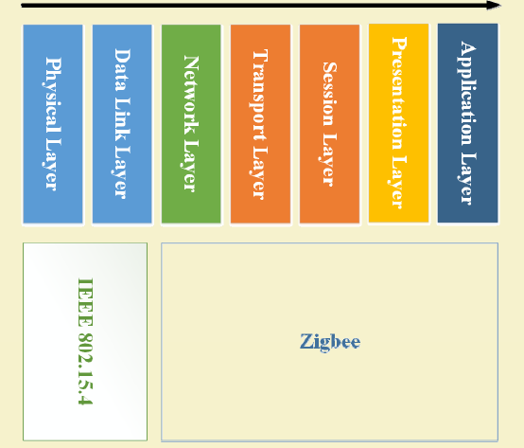
ZigBee

Slide 16
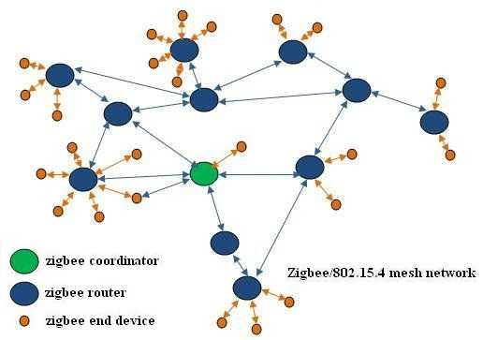
Zigbee Network Overview:

Slide 17
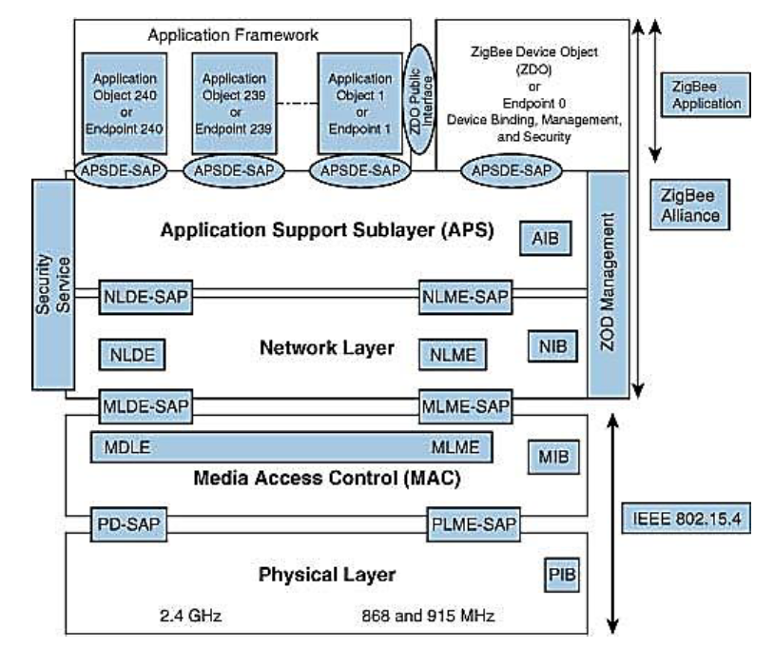
ZigBee Architecture
Divided into three sections
• IEEE 802.15.4 which consists of MAC and physical layers
• ZigBee layers, which consist of the network layer, the ZigBee device object (ZDO), the application sublayer, and security management
• Manufacturer application: Manufacturers of ZigBee devices can use the ZigBee application profile or develop their own application profile

Slide 18
The physical layer performs modulation on outgoing signals and demodulation on incoming signals.
It transmits information and receives information from a source.
Frequency Band | Country | Data Rate | Channel Numbers
868.3MHz | European countries | 20Kbps | 0
902–928 MHz | United States | 40Kbps | 1–10
2.405GHz | Worldwide | 250Kbps | 11–26

Slide 19
The functions of the MAC layer are to access the network by using carrier-sense multiple access with collision avoidance (CSMA/CA), to transmit beacon frames for synchronization, and to provide reliable transmission.

Slide 20
The network layer is located between the MAC layer and application support sublayer. It provides the following functions:
Starting a network
Managing end devices joining or leaving a network
Route discovery
Neighbor discovery

Slide 21
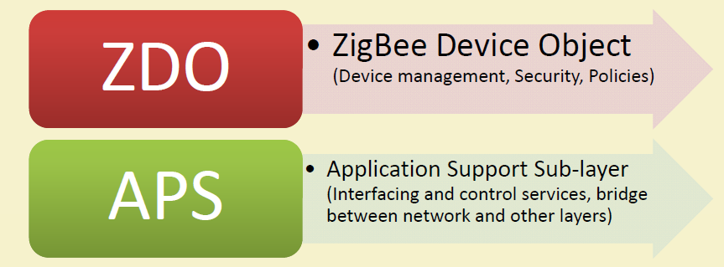
Important Components

Slide 22
Application Support Sublayer (APS)
Provides services necessary for application objects (endpoints) and the ZigBee device object (ZDO)
Some of services provided by the APS to the application objects for data transfer are
Request
Confirm
Response

Slide 23
ZigBee Device Object (ZDO)
Control and management of application objects
Performs overall device management tasks:
Determines the type of device in a network (for example, end device, router, or coordinator)
Initializes the APS, network layer, and security service provider
Performs device and service discovery
Initializes coordinator for establishing a network
Security management
Network management
ZigBee Addressing Mode
ZigBee uses direct, group, and broadcast addressing for transmission of information

Slide 24
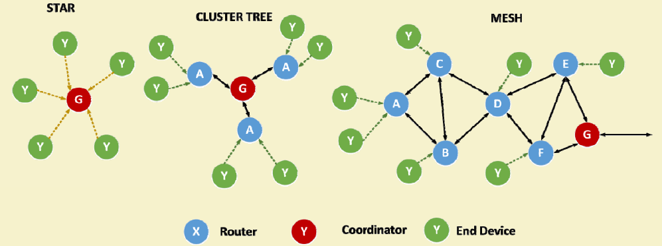
ZigBee Topologies

Slide 25
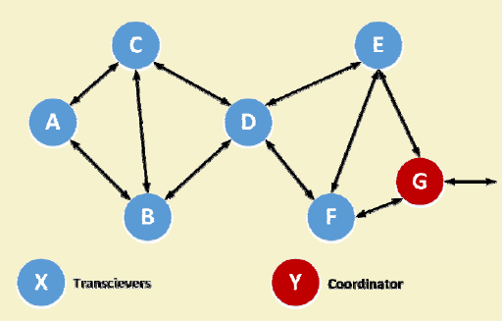
ZigBee Mesh
In a mesh, any node can communicate with any other node within its range.
If nodes are not in range, messages are relayed through intermediate nodes.
This allows the network deployment over large areas.

Slide 26
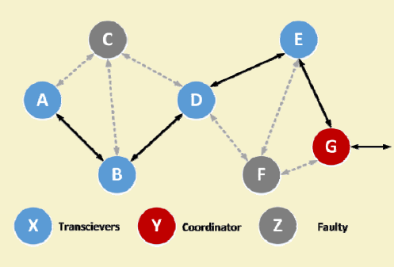
ZigBee Mesh (Contd.)
Meshes have increased network reliability.
For example, if nodes C and F are down, the message packets from A can still be relayed to G via B and E.
ZigBee mesh networks are self configuring and self‐healing.

Slide 27
ZigBee Types
ZigBee Coordinator (ZC):
The Coordinator forms the root of the ZigBee network tree and might act as a bridge between networks.
There is a single ZigBee Coordinator in each network, which originally initiates the network.
It stores information about the network under it and outside it.
It acts as a Trust Center & repository for security keys.
ZigBee Router (ZR):
Capable of running applications, as well as relaying information between nodes connected to it.
ZigBee End Device (ZED):
It contains just enough functionality to talk to the parent node, and it cannot relay data from other devices.
This allows the node to be asleep a significant amount of the time thereby enhancing battery life.
Memory requirements and cost of ZEDs are quite low, as compared to ZR or ZC.

Slide 28
Network Layer
Located between the MAC layer and application support sublayer
Provides the following functions:
Starting a network
Managing end devices joining or leaving a network
Route discovery
Neighbor discovery

Slide 29
ZigBee Network Layer
The network layer uses Ad Hoc On‐Demand Distance Vector (AODV) routing.
To find the final destination, the AODV broadcasts a route request to all its immediate neighbors.
The neighbors relay the same information to their neighbors, eventually spreading the request throughout the network.
Upon discovery of the destination, a low‐cost path is calculated and informed to the requesting device via unicast messaging.

Slide 30
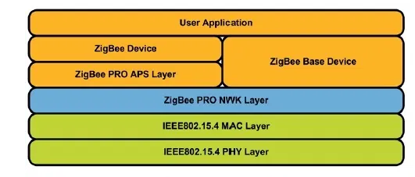
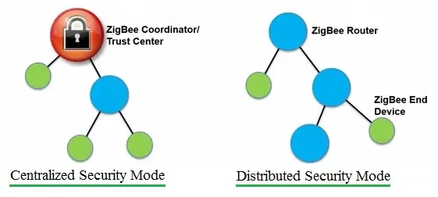
Zigbee 3.0:
Enables interoperability among different application profiles.
The security layer is enhanced and here there are two security modes supported.
Centralized: This mode is managed by central co-ordinator. This co-ordinator forms the network as well as takes care of key assignment to the new joining nodes.
Distributed: This mode does not have any central co-ordinator. The zigbee router itself manages network establishment and key assignment to peer router in the network.

Slide 31
Zigbee 3.0:
Zigbee 3.0 support large number of nodes about 250.
It also supports dynamic nature of the network.
It supports rejoining of orphaned nodes with the new parent node in the event of loss of parent.
Zigbee 3.0 provides backward compatibility with other zigbee application profiles such as zigbee light link 1.0 profile, zigbee home automation 1.2 profile etc.

Slide 32
APPLICATIONS
Building automation
Remote control (RF4CE or RF for consumer electronics)
Smart energy for home energy monitoring
Health care for medical and fitness monitoring
Home automation for control of smart homes
Light Link for control of LED lighting
Telecom services

Slide 33
6LowPAN :Introduction
Low‐power Wireless Personal Area Networks over IPv6.
Allows for the smallest devices with limited processing ability to transmit information wirelessly using an Internet protocol.
Allows low‐power and memory constrained Embedded devices to connect to the Internet.
Created by the Internet Engineering Task Force (IETF) ‐ RFC 5933 and RFC 4919.

Slide 34
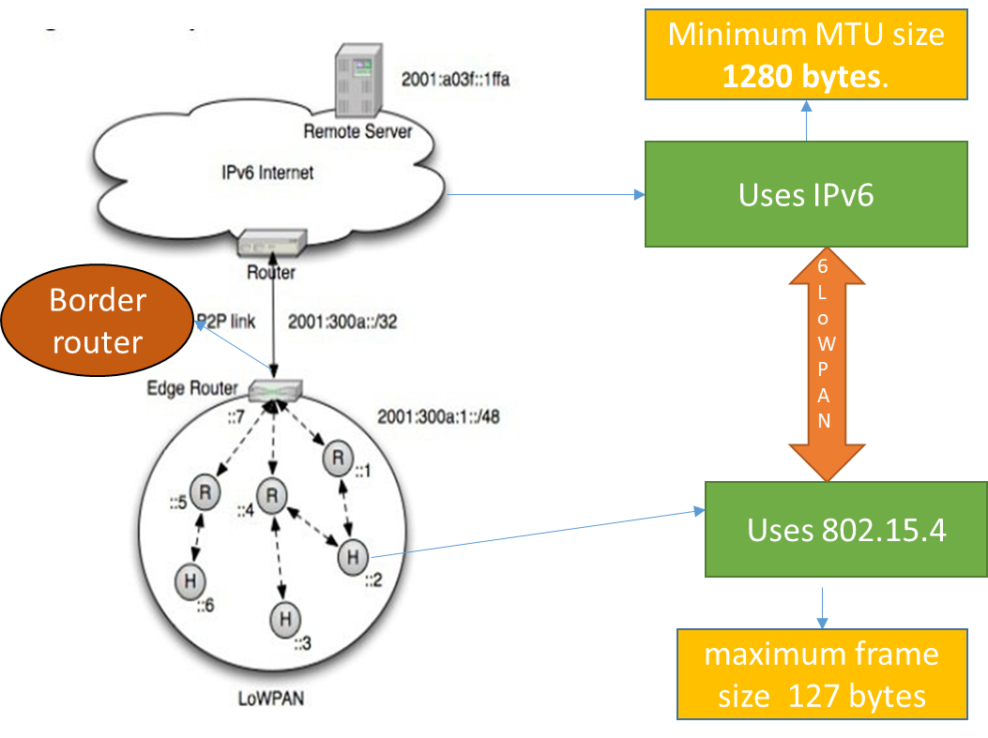
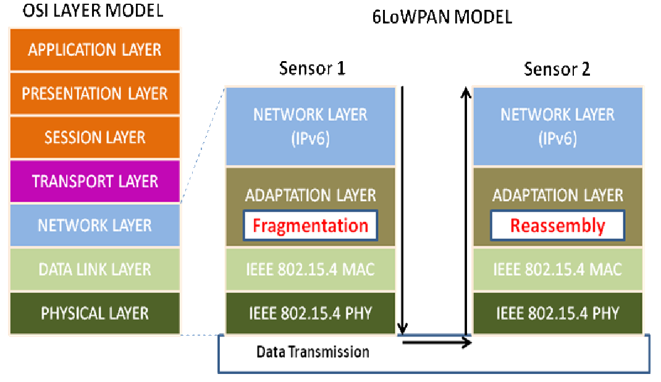
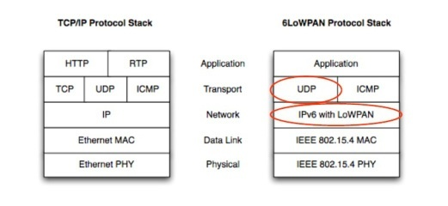
6LoWPAN
Adaptation layer

Slide 35
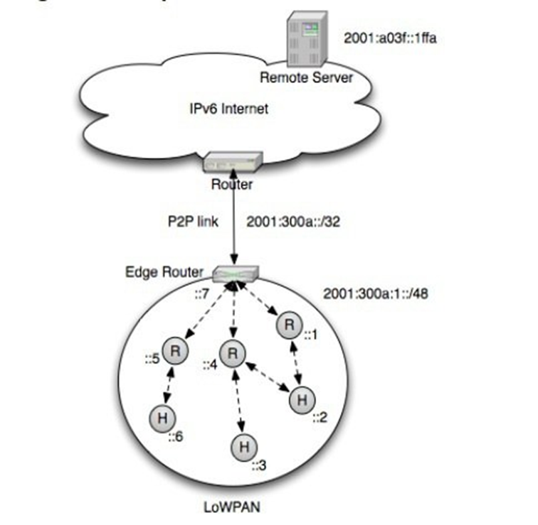
6LoWPAN
Edge Routers help a 6LoWPAN domains to get into the internet.
Edge Router performs three main tasks :
Exchange of Info between 6LoWPAN devices and the Internet.
Data exchange between the devices Present in 6LoWPAN domain.
Generation and maintenance of the radio subnet (6LoWPAN Island)
All the motes or devices within a 6LoWPAN domain share the same Prefix (IPv6 addressing )
Minimum MTU size 1280 bytes.
Uses IPv6
Border router
6LoWPAN
Adaptation Layer
Uses 802.15.4
maximum frame size 127 bytes

Slide 36
Features of 6LoWPANs
Allows IEEE 802.15.4 radios to carry 128‐bit addresses of Internet Protocol version 6 (IPv6).
Header compression and address translation techniques allow the IEEE 802.15.4 radios to access the Internet.
IPv6 packets compressed and reformatted to fit the IEEE802.15.4 packet format.
Uses include IoT, Smart grid, and M2M applications.

Slide 37
Addressing in 6LoWPAN
64‐bit addresses: globally unique
16 bit addresses: PAN specific; assigned by PAN coordinator
IPv6 multicast not supported by 802.15.4
IPv6 packets carried as link layer broadcast frames
Addressing
64 bit Extended
16 bit Short

Slide 38
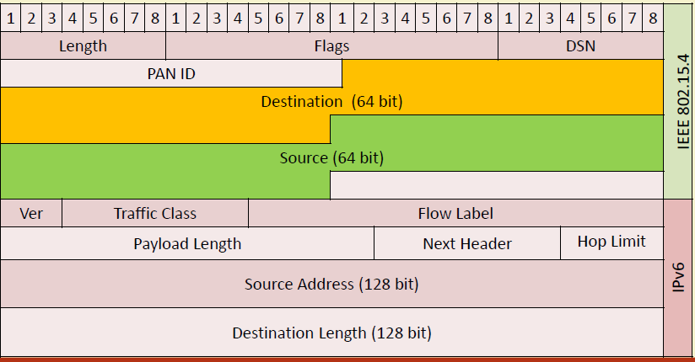
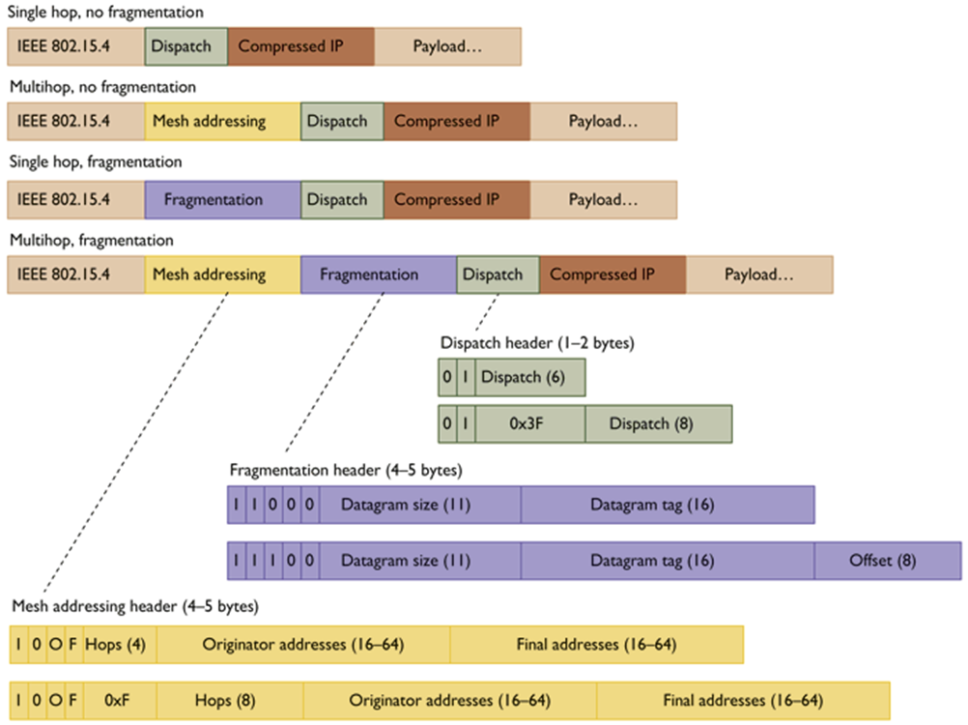
6LoWPAN Packet format

Slide 39
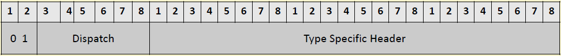
Header Type: Dispatch Header
Dispatch: Initiates communication
• 0,1: Identifier for Dispatch Type
• Dispatch:
• 6 bits
• Identifies the next header type
• Type Specific Header:
• Determined by Dispatch header

Slide 40
Header Type: Mesh Addressing Header
1,0: ID for Mesh Addressing Header
• V: ‘0’ if originator is 64‐bit extended address, ‘1’ if 16‐bit address
• F: ‘0’ if destination is 64‐bit addr., ‘1’ if 16‐bit addr.
• Hops Left: decremented by each node before sending to next hop

Slide 41
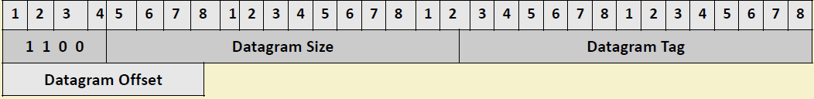
Header Type: Fragmentation Header
(a) First Fragment
(b) Subsequent Fragment

Slide 42
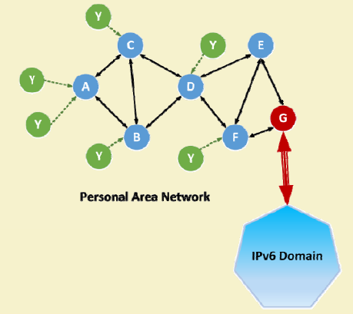
6LoWPAN Routing Considerations
Mesh routing within the PAN space.
Routing between IPv6 and the PAN domain
Routing protocols in use:
LOADng
RPL

Slide 43
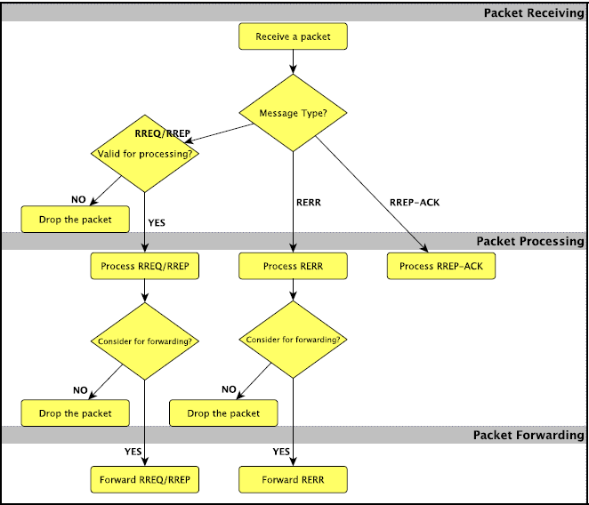
LOADng Routing
Lightweight On-demand Ad hoc Distance-vector Routing Protocol – Next Generation (LOADng) is a routing protocol,
Derived from AODV and extended for use in Mobile Ad hoc NETworks (MANETs) and Low-power and Lossy Networks (LLNs).
Basic operations of LOADng include:
Generation of Route Requests (RREQs) by a LOADng Router (originator) for discovering a route to a destination,
Forwarding of such RREQs until they reach the destination LOADng Router,
Generation of Route Replies (RREPs) upon receipt of an RREQ by the indicated destination, and unicast hop‐by‐hop forwarding of these RREPs towards the originator.

Slide 44
Route Discovery Process
B
RREQ
E
RREQ
RREQ
RREQ
C
G
A
RREQ
RREQ
RREP
RREQ
F
RREQ
RREP
RREQ
Destination
Source
RREP
RREQ
D
RREQ

Slide 45
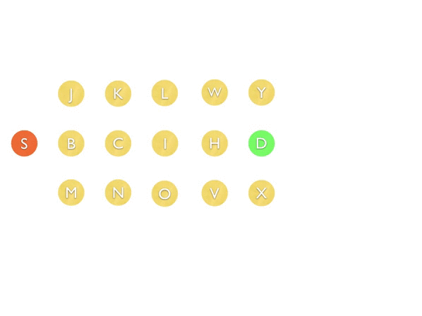
An example of RREQ message flooding
Router S initiates a route discovery to Router D.
The RREQ message generated by Router S is retransmitted by other routers and flooded in the network until it reaches the destination router D.
All the intermediate routers will set up a “reverse route” to Router S.

Slide 46
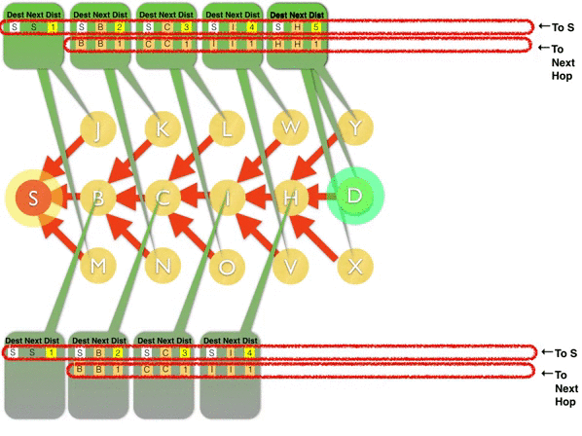
How unicast RREP message forwarding works
When the RREQ message reaches the destination router D, D will generate an RREP message.
The RREP is unicast to the route discovery originator S following the reverse route established during the RREQ flooding.
All the routers receiving the RREP message will establish a “forward route” to Router D.

Slide 47
Route Maintenance
If a route is detected to be broken, a Route Error (RERR) message is returned to the originator of that data packet to inform the originator about the route breakage.
Optimized flooding is supported, reducing the overhead incurred by RREQ generation and flooding.
Only the destination is permitted to respond to an RREQ.
Intermediate LOADng Routers are explicitly prohibited from responding to RREQs, even if they may have active routes to the sought destination.
RREQ/RREP messages generated by a given LOADng Router share a single unique, monotonically increasing sequence number.

Slide 48
Smart Route Request
Avoid flooding of network by RREQ
If a intermediate node already knows the destination route, then directly RREQ is sent to destination.
Why don’t intermediate node inform source?
B
RREQ
E
RREQ
RREQ
RREQ
C
G
A
RREQ
RREQ
RREP
RREQ
F
RREQ
Source
RREP
Destination
If D knows the destination
RREP
RREQ
D
RREQ

Slide 49
Expanding Ring Search
Reduce the overhead & power
Case-1
Low TTL(time to live)
If destination is in the vicinity of the source
Case-2
High TTL
If destination is in the far away from the source
Case-1 Destination
B
RREQ
E
RREQ
RREP
RREQ
RREQ
C
G
A
RREQ
RREQ
RREP
RREQ
F
RREQ
RREP
RREQ
Case-2 Destination
Source
RREP
RREQ
D
RREQ

Slide 50
Collection Tree Protocol
B
H
Appoint a Collection node in each PAN
Stores the address of all the nodes
Forwards the RREQ packets to the intended destination
A
C
G
I
R
R
F
D
J
E
K
Source
Destination

Slide 51
RPL Routing
Developed by IETF Routing over Low-Power and Lossy Networks (ROLL) working group
Low-Power and Lossy Networks (LLN) Routers have constraints on processing, memory, and energy.
Can’t use OSPF, OLSR, RIP, AODV, DSR, etc
LLN links have high loss rate, low data rates, and instability
expensive bits, dynamically formed topology
Covers both wireless and wired networks
Requires bidirectional links. May be symmetric/asymmetric.
Ideal for n-to-1 (data sink) communications, e.g., meter reading 1-to-n and 1-to-1 possible with some extra work.
Multiple LLN instances on the same physical networks
Proactive: Maintaining routing topology.
Reactive: Resolving routing inconsistencies.

Slide 52
RPL Routing
RPL separates packet processing and forwarding from the routing optimization objective, which helps in Low power Lossy Networks (LLN).
RPL supports message confidentiality and integrity.
Supports Data‐Path Validation and Loop Detection
Routing optimization objectives include
minimizing energy
minimizing latency
satisfying constraints (w.r.t node power, bandwidth, etc.)

Slide 53
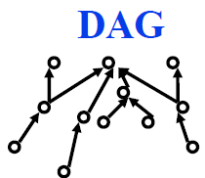
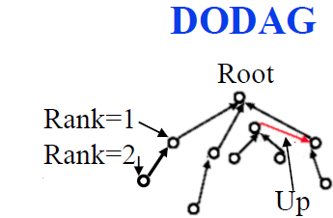
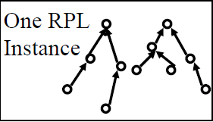
RPL Concepts
Directed Acyclic Graph (DAG): No cycles
Root: No outgoing edge
Destination-Oriented DAG (DODAG): Single root
Up: Towards root
Down: Away from root
Objective Function: Minimize energy, latency, …
Rank: Distance from root using specified objective
RPL Instance: One or more DODAGs. A node may belong to multiple RPL instances.
DODAG ID: IPv6 Adr of the root
DODAG Version: Current version of the DODAG. Every time a new DODAG is computed with the same root, its version incremented

Slide 54
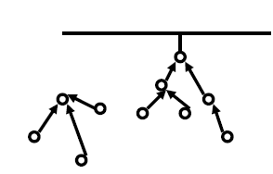
RPL Concepts (Cont)
Goal: Reachability goal, e.g., connected to database
Grounded: Root can satisfy the goal
Floating: Not grounded. Only in-DODAG communication.
Parent: Immediate successor towards the root
Sub-DODAG: Sub tree rooted at this node
Storing: Nodes keep routing tables for sub- DODAG
Non-Storing: Nodes know only parent. Do not keep a routing table.

Slide 55
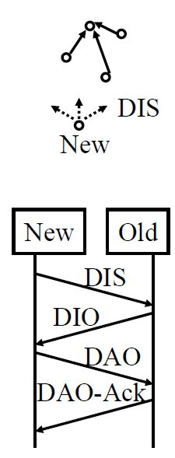
RPL Control Messages
1. DODAG Information Object (DIO): Downward RPL instance multicasts
Allows other nodes to discover an RPL instance and join it
2. DODAG Information Solicitation (DIS): Link-Local multicast request for DIO (neighbor discovery). Do you know of any DODAGs?
3. Destination Advertisement Object (DAO): From child to parents or root. Can I join you as a child on DODAG #x?
4. DAO Ack: Yes, you can! Or Sorry, you cant!
5. Consistency Check: Challenge/response messages for security

Slide 56
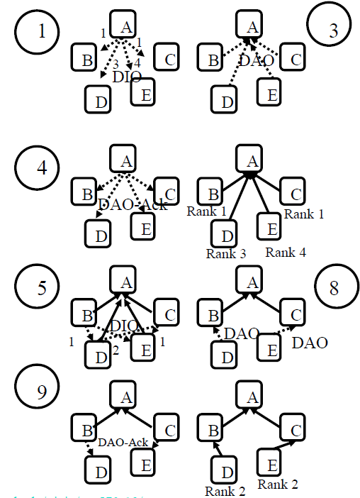
DODAG Formation Example
A multicasts DIOs that it’s member of DODAG ID itself with Rank 0.
B, C, D, E hear and determine that their rank (distance) is 1, 1, 3, 4, respectively from A
B, C, D, E send DAOs to A.
A accepts all
B and C multicast DIOs
D hears those and determines that its distance from B and C is 1, 2
E hears both B, C and determines that its distance from B and C is 2, 1
D sends a DAO to B E sends a DAO to C
B sends a DAO-Ack to D C sends a DAO-Ack to E

Slide 57
References
1. T. Winter, P. Thubert, A. Brandt, J. Hui, R. Kelsey, P. Levis, K. Pister, R. Struik , JP. Vasseur, R. Alexander,
“RPL: IPv6 Routing Protocol for Low‐Power and Lossy Networks”, IETF, Standards Track, Mar. 2012
2. Clausen, T.; Colin de Verdiere, A.; Yi, J.; Niktash, A.; Igarashi, Y.; Satoh, H.; Herberg, U.; Lavenu, C. et al. (January 2016). The Lightweight On‐demand Ad hoc Distance‐vector Routing Protocol ‐ Next Generation (LOADng). IETF. I‐D draft‐clausen‐lln‐loadng‐
3. T. Agarwal, “ZigBeeWireless Technology Architecture and Applications”, Electronics Projects Focus (Online)

Slide 58
Thank You…

